Slide 1

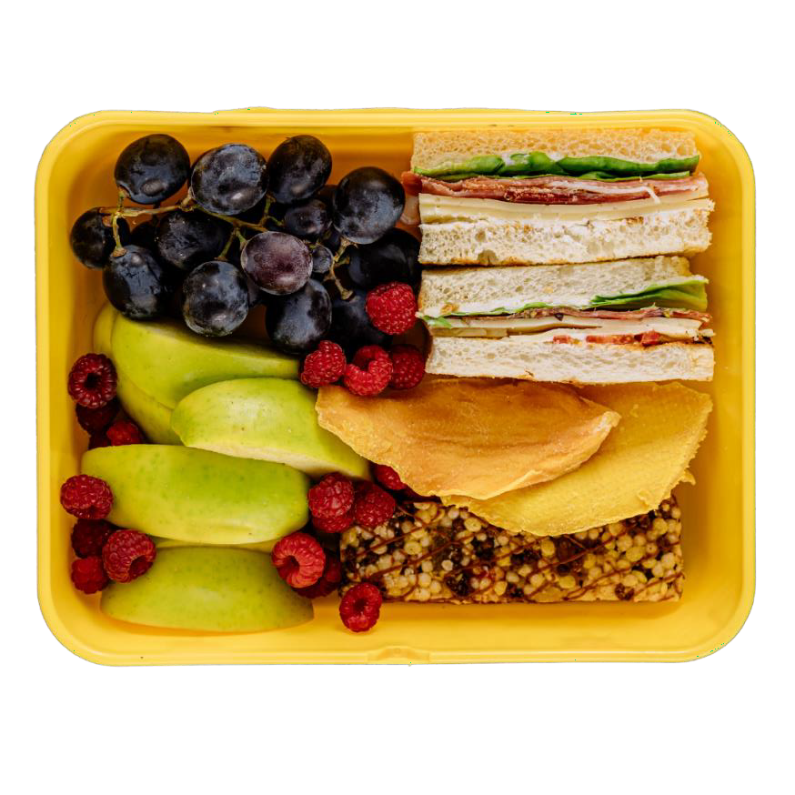
What is for Lunch and Snack?

Slide 2
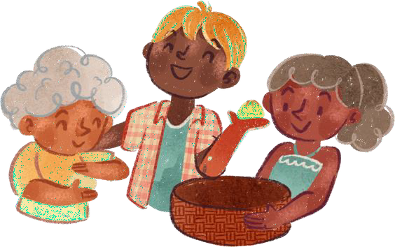
Dear Families,
Children can learn that there are many types of food in the world. It is important that you send the food that your child and family enjoy at home. Families can talk to their children about different foods families may eat. Eating together is a fabulous way for a class to talk about food, kindness, and trying new things.
It’s ok to say and ask “I have never seen that before. What is it?”
All children should feel welcome to bring food they enjoy and are familiar with. Let your teacher know if you have any questions. We are happy to help.

Slide 3
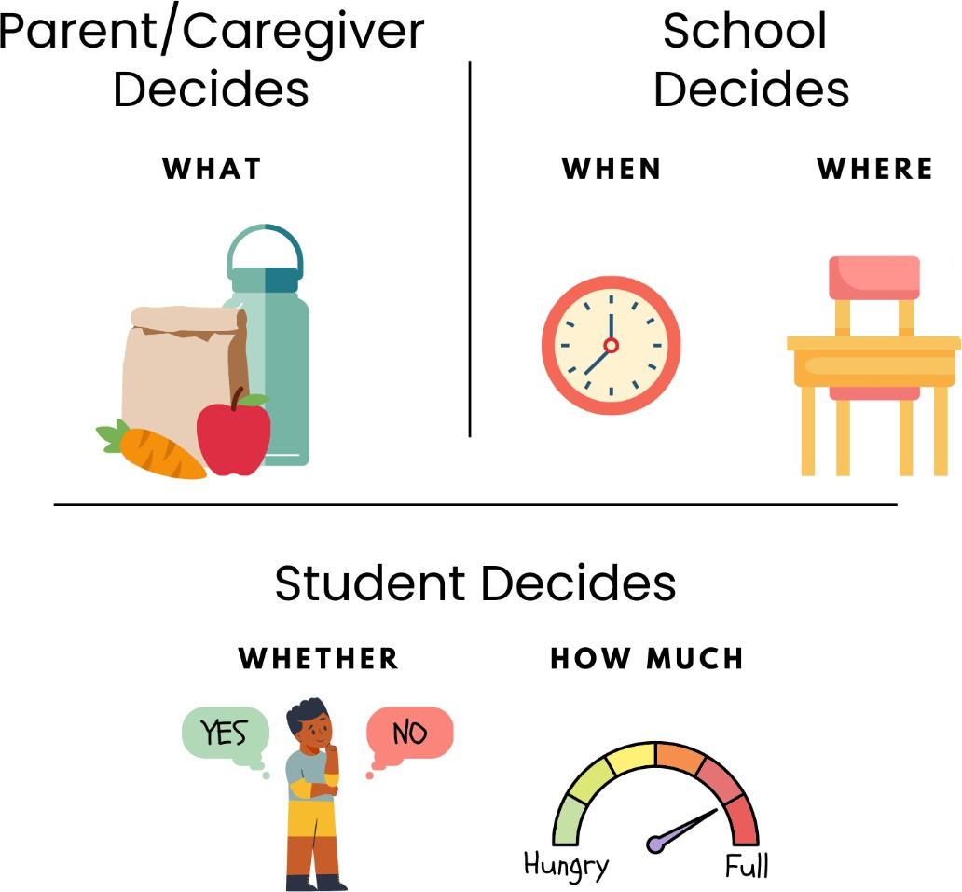
What is Your Meal Time Role?
When parents/caregivers and schools do their job with feeding, children can do their job with eating.

Slide 4
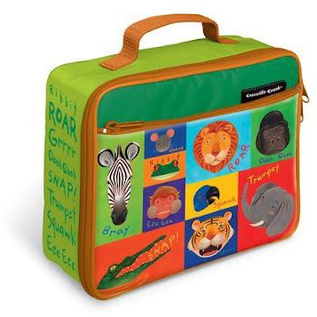
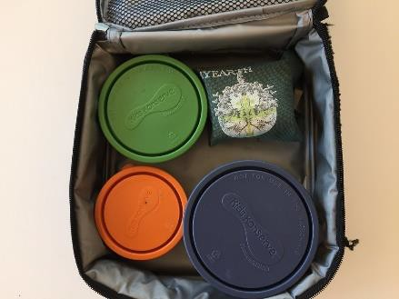
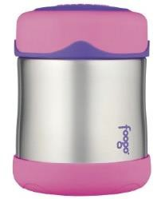
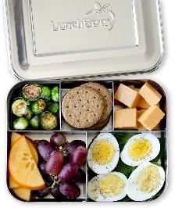
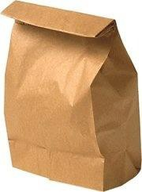
Ways to Bring a Lunch
Lunch kit to hold everything
Thermos
Bento Box
Paper Bag

Slide 5
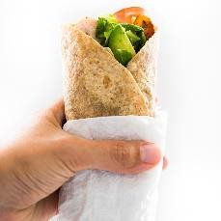
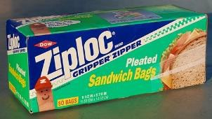
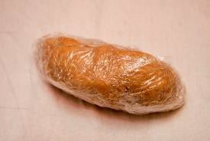
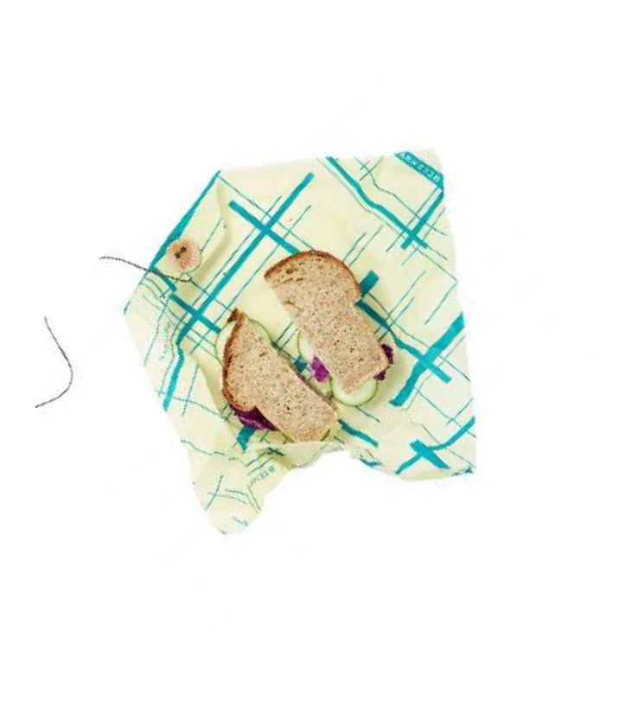
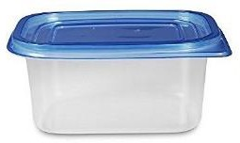
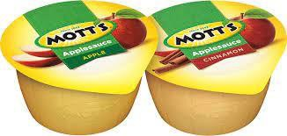
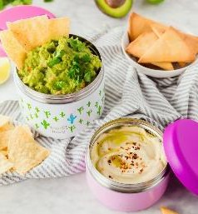
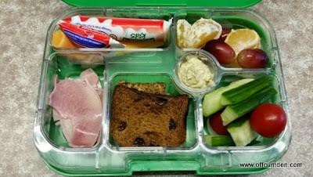
Ways to Pack Food
Ziploc Bags
Saran Wrap
Wax Paper
Plastic Container with a Lid
Bees Wax Wrap
Prepackaged Snacks
Metal container
with Lid
Divided container

Slide 6
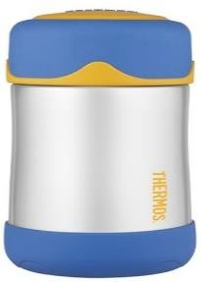
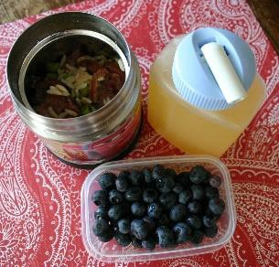
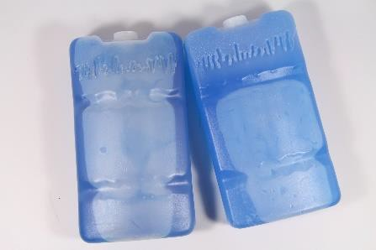
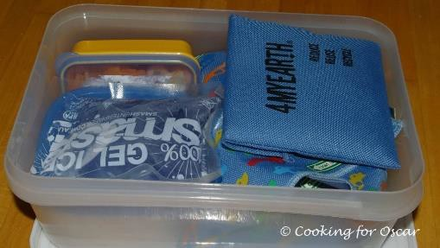
How to Keep Food Hot or Cold
Thermos
Freezer Ice Packs

Slide 7
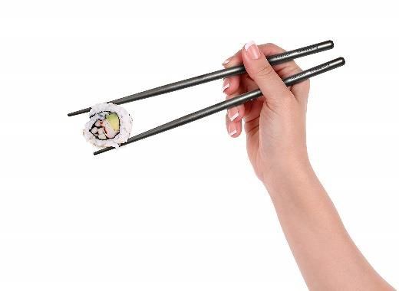
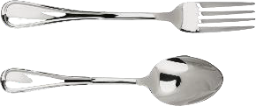
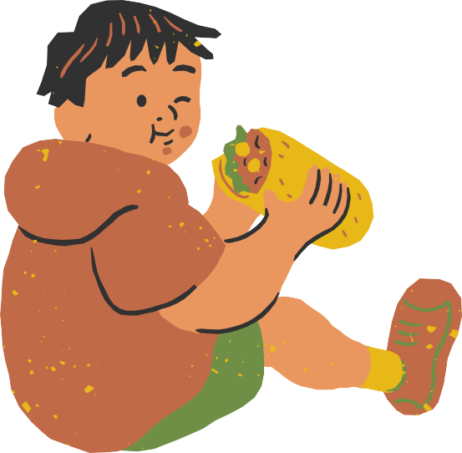
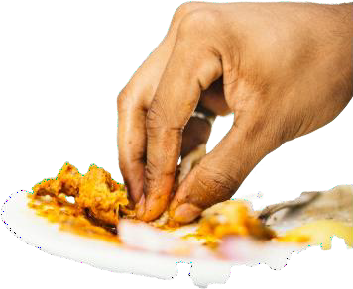
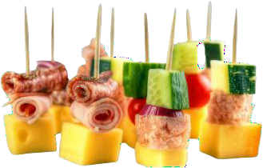
Ways People Eat
Spoon / Fork
Chopsticks
Fingers
Toothpicks

Slide 8
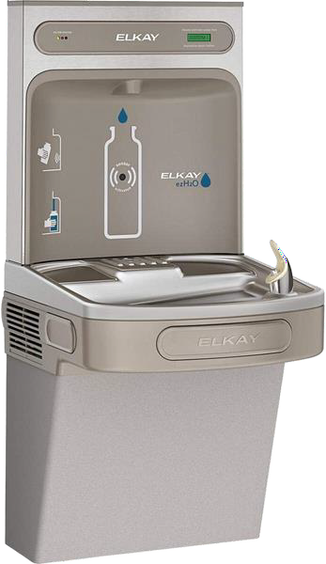
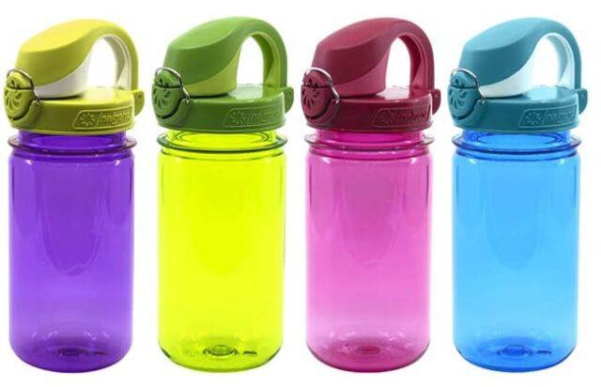
Bring a Refillable Water Bottle
Drinking Fountain

Slide 9
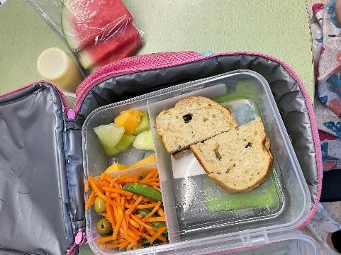
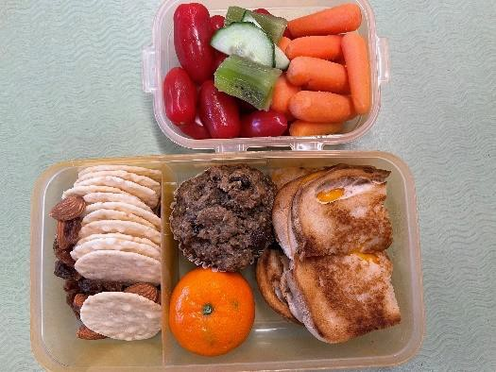
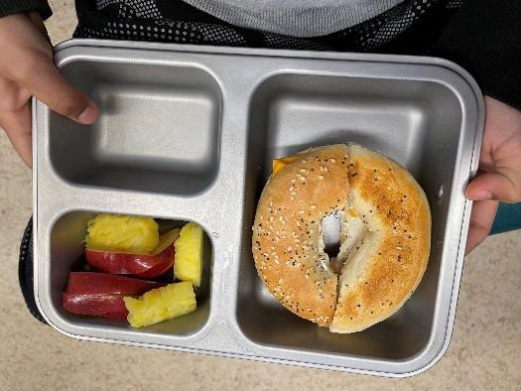
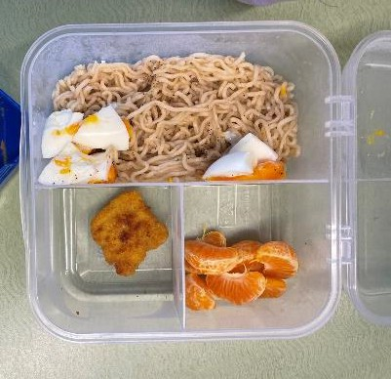
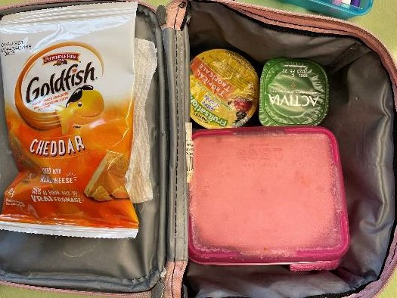
Examples of a Packed Lunch

Slide 10
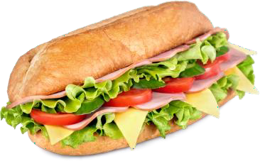
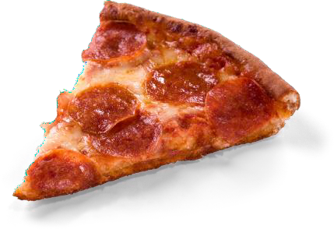

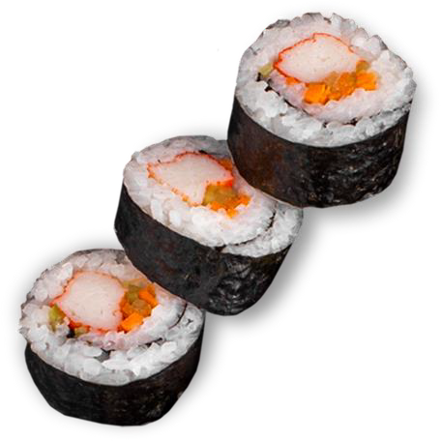

There may be a
‘hot lunch day’.
Families can choose to order and pay for it.

